Slide 1

NATIONAL INSTITUTE OF TECHNOLOGY, KARNATAKA
Emergent Properties, Models, and Laws of Behavioral Similarities
within Groups of Twitter Users
Presented by
Shaikh Sahil Ahmed (192IT022)
Sampat Kr. Ghosh (192IT020)
Kushal Mondal(192IT008)
Under the guidance of
Dr. Sowmya Kamath

Slide 2
Introduction
Occurence of behavioral similarities among Twitter users employing a DNA inspired technique.
Chronological sequence of action of a user leads to the creation of a string named digital DNA (for representing user’s behavior).
Comparison of real online behaviors with randomized null models (simple models that are partially capable of explaining the behavioral similarity among group of users).
Characterization of human online behavior to detect groups containing bot accounts.

Slide 3
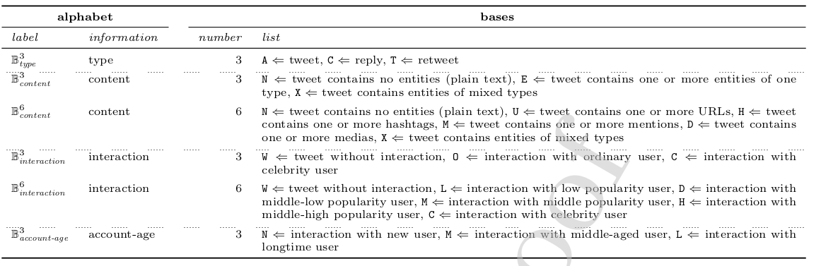
Definitions of the alphabets and the bases

Slide 4
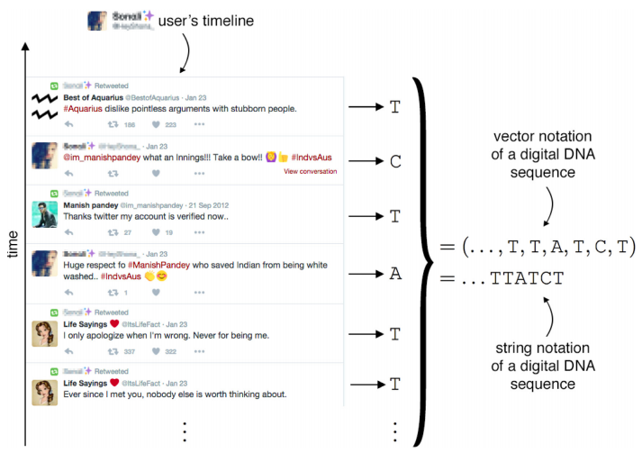
Digital DNA
Row vector of characters (i.e a string) - Digital DNA

Slide 5
Longest Common Subsequence (LCS)
Si = CHARLIE Sj = LIMA LCS = LI
K-common substring problem
Measuring similarity for the whole group, compute the area under the LCS curve.
(Group A having M users)
Length of LCS
K accounts

Slide 6
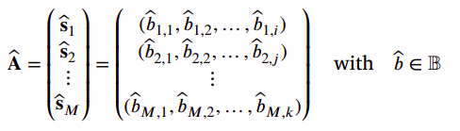
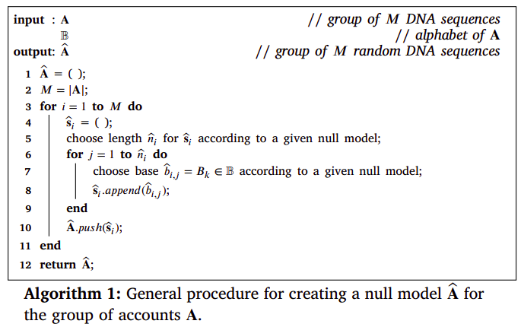
Generating Null models
Given a group A of M accounts, defined in Equation, with a digital DNA derived from alphabet B, the task of defining a null model Â for A lies in creating a set of M random sequences ŝ so that,

Slide 7
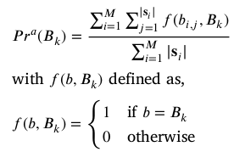
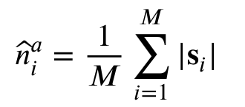

3 Null Models
Average null model
Bootstrap null model: Sampling with replacement
Permutation null model: Sampling without replacement

Slide 8
4. Statistical Characterization of behavior
Observation of heavy-tailed phenomena in obtained LCS curve
Objective: Model statistical distribution with empirical observation to characterise features.
Chosen statistical distribution to support heavy-tailed characteristics:
Poisson distribution
Power-law (Pareto distribution)
Log-Normal
Exponential

Slide 9
Statistical characterization of behavior...continued
Human operated account has distinctive log-normal behavior with much heterogeneity.
Bots group behavior is traced with with reference to the human accounts behavior.
Definition of threshold that decides whether the distance between two behavior is significant enough.
Probable presence of bots when threshold breached.

Slide 10
5. Application scenario
Percentage of bots in Twitter in estimated to 9-15%
Distribution of such bots are not even and mostly interacts with important and controversial topics
Therefore, possible area of detection is restricted in a subset of Twitter network.

Slide 11
Thank You!

